Slide 1

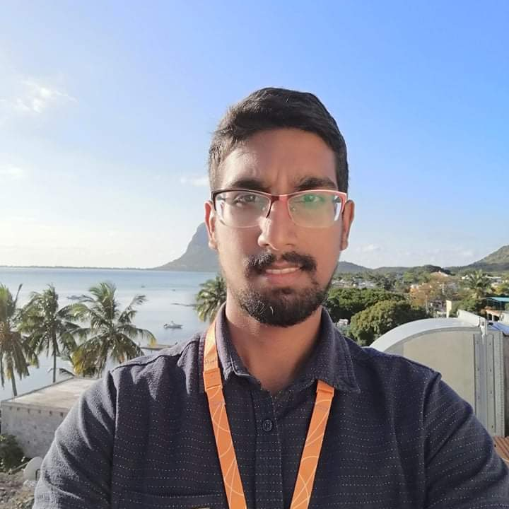

Experience
Areas of expertise
Functional
Agile / Design Thinking
Software Engineering
Technical
SQL(SSMS)/SSIS
Power BI
DAX
SSAS
Azure services
AWS
Web (HTML/CSS/JS/PHP)
Python
Java/Spring
Eiffage (Avanade) (July 2021 – Dec 2021)
Data engineer
Archive data to SQL DB using SSIS.
Develop and test database solutions.
Develop Power BI Report
Data Engineer (Avanade) (Feb 2021- July 2021)
Azure Fundamentals, Power BI and Power Apps
Develop mobile app using SQL, SSAS, Power BI and Power Apps
Telecom Engineer Intern (Huawei Mauritius) (June 2019- June 2020)
Worked in wireless and networking Dept.
Vimalen ARMOOGUM
Application Developer
Education
Application Development Associate
MSc Applied Software Technologies
University of Mauritius, 2020-2021
BEng (Hons) Electronic and Communication
Engineering
University of Mauritius, 2015-2019
AZ 900 Microsoft Azure Fundamentals
DP 900 Microsoft Azure Data Fundamentals
DA 100 Microsoft Certified: Data Analyst Associate
PL 300 Microsoft BI Data Analyst
AWS Certified Cloud Practitioner
Professional background
Experience in SQL, SSIS, SSAS, Azure, Power BI, Agile
Proficiency in SSMS/Microsoft Visual Studio to develop components of SQL server and Power BI Desktop to develop BI reports
Profile:
Dedicated
Always willing to learn and improve
Certification

Slide 2

Application Developer
July 2021 – Dec 2021
Eiffage
-Extract, Transform and Load data to SQL server for creation of Power BI reports
-Data modelling and loading using SSIS
-Develop Power Bi report as per clients' requirements
Data Manipulation
Archive data from SQL servers or flat files to SQL DB using SSIS.
Development of SSIS packages, testing and deployment
Develop and test SQL databases queries and stored procedures.
Power Query / Modelization
Documentation of Azure Data Factory pipelines
Data Visualization
Develop Power BI Report to analyze and monitor Ticketing service level
Project
Develop and update technical documentations.
Application Developer
Skills & Technology applied
Skills
Analytical abilities
Communication
Technology
SSIS
SQL Server 2019 (On Premise)
Power BI and DAX
Azure Data Factory

Slide 3

Application Developer
Feb 2022– May 2022
Elior Group
-Clearing bugs in existing Power BI reports
-Data modelling using SSAS
-Develop Power Bi report as per clients' requirements
Data Manipulation
Develop and test SQL databases queries.
Develop and test measures in SSAS cube.
Power Query / Modelization
Assisted in creating Data Factory Pipelines
Data Visualization
Develop Power BI Report to analyze and monitor data model of client.
Project
Develop and update technical documentations.
Application Developer
Skills & Technology applied
Skills
Analytical abilities
Communication
Technology
SSAS
SQL Server 2019 (On Premise)
Power BI and DAX
Azure Data Factory
Logic App
Azure DevOps

Slide 4

Telecom Engineer
June 2019 – June 2020
Huawei Mauritius
Engineer in Delivery and Service Dept
Assisted in 4G network deployment
Supervised hardware installation for 4G network projects and Safe City projects
Worked in network dept of Safe City project
Configured network equipments using SSH, SNMP and Telnet
Skills & Technology applied
Communication Engineer
Skills
Communication
Analytical abilities
Technology
SQL
4G
Networking tools

